Slide 1


Statistical Modelling with Data
May 23 – June 02, 2023
Instructor: Qing (Leah) Li, Ph.D. Candidate at Cumming School of Medicine
qing.li2@uclagary.ca
Thank you Dr. Thuntida Ngamkham for contributing the contents
Thank you Dr. Qingrun Zhang and Dr. Quan Long for contributing some slides

Slide 2
Statistical Modelling with Data
Topic 1: Statistical Modelling
Lecture 1: First-order models with quantitative independent variables
Topic 2: Statistical Modelling with interactions (Assignment 1)
Lecture 2: Interaction effects, quantitative and qualitative variables
Lecture 3: Interaction effects and second-order models
Topic 3: Statistical Model selection (Assignment 2)
Lecture 4: Model selection: Stepwise regression, Forward selection and Backward Elimination
Lecture 5: Model selection: Evaluate the reliability of the model chosen
Topic 4: Statistical model diagnostics
Lecture 6: Multiple regression diagnostics: verify linearity, independence, and equal variance assumptions.
Lecture 7: Multiple regression diagnostics: verify normality assumptions and identify multicollinearity and outliers.
Lecture 8: Multiple regression diagnostics: data transformation
Topic 5: Transfer learning
Lecture 9: Transfer-learning (Bonus): standing on the shoulders of giants.

Slide 3
Statistical Modelling with Data
Topic 1: Statistical Modelling
Lecture 1: First-order models with quantitative independent variables
Topic 2: Statistical Modelling with interactions (Assignment 1)
Lecture 2: Interaction effects, quantitative and qualitative variables
Lecture 3: Interaction effects and second-order models
Topic 3: Statistical Model selection (Assignment 2)
Lecture 4: Model selection: Stepwise regression, Forward selection and Backward Elimination
Lecture 5: Model selection: Evaluate the reliability of the model chosen
Topic 4: Statistical model diagnostics
Lecture 6: Multiple regression diagnostics: verify linearity, independence, and equal variance assumptions.
Lecture 7: Multiple regression diagnostics: verify normality assumptions and identify multicollinearity and outliers.
Lecture 8: Multiple regression diagnostics: data transformation
Topic 5: Transfer learning
Lecture 9: Transfer-learning (Bonus): standing on the shoulders of giants.
Notes:
The first lecture does not frighten you. I hope you can still bare with my English with accents for the rest of courses.
Many I ask some of your feedbacks for yesterday’s courses? You know these courses won’t be graded and all we ask is to attend six lectures to get the certificate. However, there must be something more than certificate you want to get from this course. I hope that I can really help you understand some basics of statistical modelling. I am not sure what’s your exceptions from this course.

Slide 4
Statistical Modelling with Data
Learning Outcomes: At the end of the course, participants will be able to
Model the multiple linear relationships between a response variable (Y) and all explanatory variables (both categorical and numerical variables) with interaction terms. Interpret model parameter estimates, construct confidence intervals for regression coefficients, evaluate model fits, and visualize correlations between a response variable (Y) and all explanatory variables (X) by graphs (scatter plot, residual plot) to assess model validity.
Predict the response variable at a certain level of the explanatory variables once the fit model exists.
Implement R-software and analyze statistical results for biomedical and other data.
Evaluations
Assignments will be posted on Slack (our communication tool with students).
Students must attend 70% (6/9) of the sessions in order to receive the certificate and are encouraged to work on the assignments progressively throughout the course as the relevant material is covered.

Slide 5

Statistical Modelling with Data
Supportive materials
Lectures slides (2023)
R code scripts (2023)
PDF (dated 2022)
Two Assignments (dated 2022)
Slack channels
Recoding videos
Exercises
Course-documents

Slide 6

Lecture 5: Model Selection, evaluate the reliability of the model chosen

Slide 7


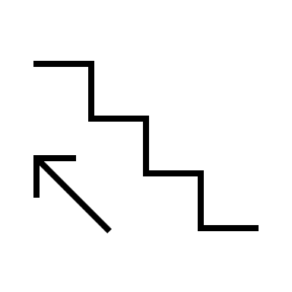
Quick recap of lecture 4
Full model
Backward Elimination
Library(olsrr)
ols_step_backward_p
ols_step_forward_p
ols_step_both_p
Statistics:
Backward elimination
Forward selection
Stepwise regression
All Possible Regressions Selection Criteria (makes your own combos of selection criteria)
R square
adjusted R²
Mallows’s Cp Criterion
AIC (Akaike’s information criterion) or BIC (Bayesian information criterion)
RMSE
Code:
lm(); anova();
ols_step_backward_p
ols_step_forward_p
ols_step_both_p
rbind(); cbind(); colnames(); write.csv(); getwd()
Forward selection
(Stepwise regression)
Null model
Criteria Combos 5 | R2 (+) | Adjusted R2 (+) | Cp (k+1) | AIC/BIC (-) | RMSE (-)
Model1
…
Model5
Cp < k +1, sampling errors, no bias between predicted values and actual values
Cp near k +1, the optimal model
Cp > k +1, substantial bias between predicted values and actual values
1
k+1
p+1

Slide 8


In class Practice Problem 13
Use the CREDIT.CSV data.
From the credit card example, using the All Possible Regressions Selection Criteria (combo5) to analyze which independent predictors should be used in the model.
Hints: construct criterion combos 5 tables for the best models you get from problem 11, 12 and make a final decision.
Lecture_4.R
8

Slide 9
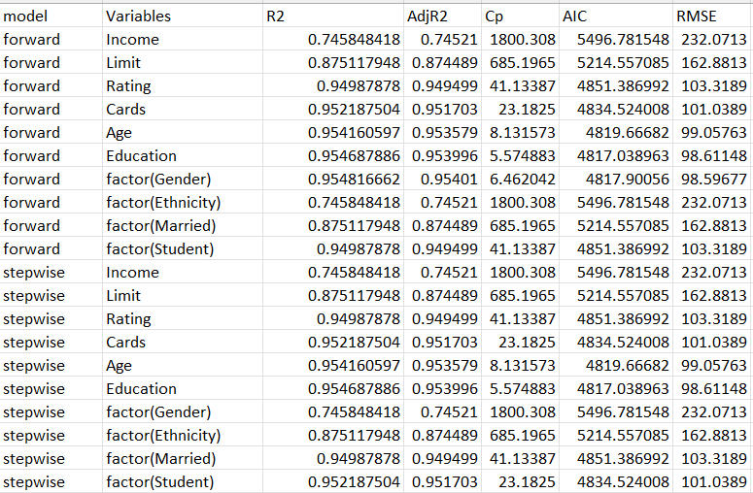
In class Practice Problem 13
Pros:
Cons:
The model's performance in relation to all predictors is evident.
Not dynamically displaying how predictors are added or deleted.
Lecture_4.R
9

Slide 10
Combos 5
Model selection functions, such as ols_step_backward_p, ols_step_forward_p, ols_step_both_p, include or exclude predictor on their coefficients’ p-values. Additionally, these functions also give values for criteria combos 5.
Does the optimal model constructed based on p-values (ols_step_backward_p, etc.) matches the one uses criteria combos 5?
To answer this question: we use the function named “ols_step_best_subset”

Slide 11
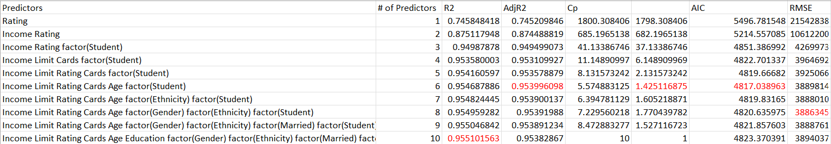
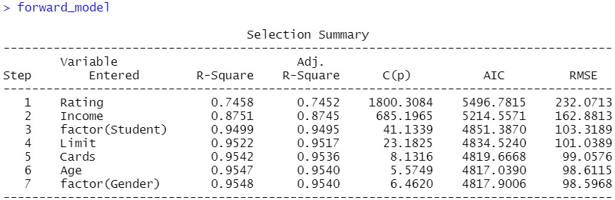
Comparison of the optimal models
The optimal model based on criteria combos 5
The optimal model using forward selection procedure
These two results do not match with each other. Which one should we choose?
>> Based on your circumstances.
Maybe more information the better.

Slide 12
Evaluate the reliability of the model chosen
After using model selection by automatic methods (ols) or all possible regression methods (combos 5), we might not have the best fit model yet, as we consider only main effects on independent variables. After eliminating some variables that are not important out of the model, we consider interaction terms and/or high order multiple regression model to improve the model.

Slide 13
In class Practice Problem 14
Use the CREDIT.CSV data.
Include interaction terms and higher order terms to improve the optimal first-order model we got.
The Credit data set records balance (average credit card debt for a number of individuals) as well as several quantitative predictors: age, cards (number of credit cards), education (years of education), income (in thousands of dollars), limit (credit limit), and rating (credit rating). In addition to these quantitative variables, we also have four qualitative variables: gender, student (student status), status (marital status),
and ethnicity (Caucasian, African American or Asian).
Lecture_4.R
13

Slide 14
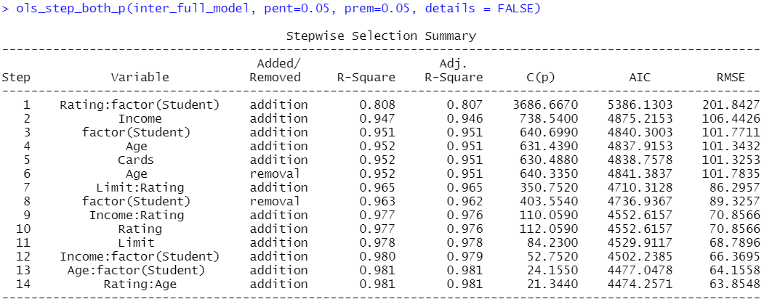
In class Practice Problem 14 Answers
Lecture_5.R
14

Slide 15
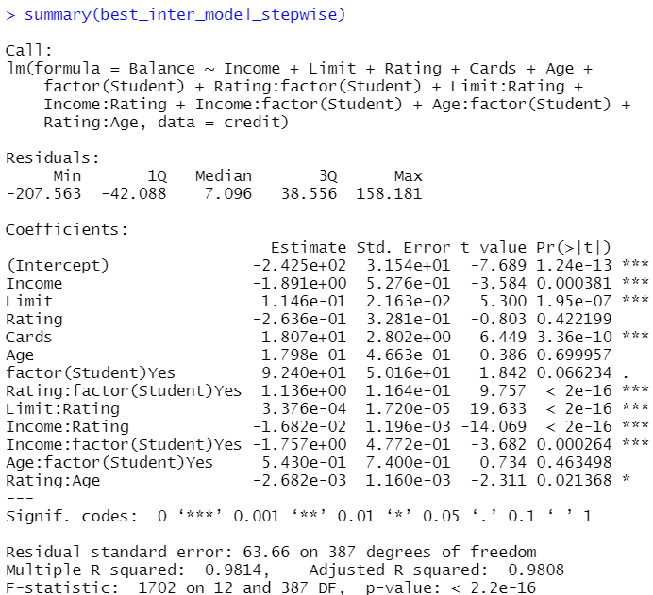
In class Practice Problem 14 Answers
Lecture_5.R
15

Slide 16
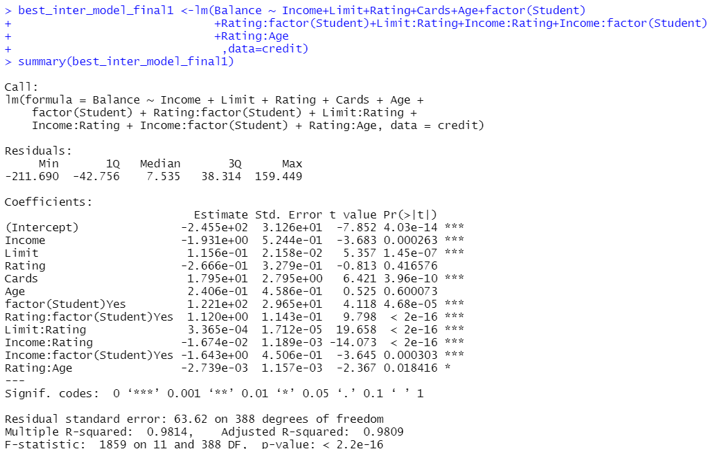
In class Practice Problem 14 Answers
Lecture_5.R
16

Slide 17
In class Practice Problem 14 Answers
It takes too much time to run ols_step_best_subset and construct the Combos 5 table. Let’s quit.
Lecture_5.R
17

Slide 18
In class Practice Problem 14 Answers
Add high order terms [Income, Limit, Rating, Cards, Age].
Lecture_5.R
18

Slide 19

Coffee break
Come back at 14:35 pm to check the ols_step_best_subset results
This Photo by Unknown Author is licensed under CC BY-SA
Notes:
"It's time for a break!"
"Let's take a moment to relax and recharge."
"Enjoy your break!"
"Take this opportunity to unwind and refresh."
"We've worked hard, now it's time to take a breather."
"Let's step away from our tasks for a little while."
"Use this break to stretch, grab a snack, or do something enjoyable."
"Take a well-deserved break and come back feeling rejuvenated."
"Pause for a moment and give yourself a chance to rest."
"Take this break to clear your mind and come back with renewed focus.“
"Welcome back, everyone!"
"I hope you enjoyed your break. Let's get back to work."
"I hope you're feeling refreshed and ready to dive back in."
"Alright, let's pick up where we left off before the break."
"I hope the break provided the energy boost we needed. Let's continue our progress."
"I'm glad to see everyone back. Let's resume our tasks."
"I hope you had a productive break. Now let's continue with our work."
"Let's refocus and get back into the flow of things."
"Welcome back, team! Let's make the most of our time remaining."
"I trust everyone had a rejuvenating break. Now let's hit the ground running.“

Slide 20
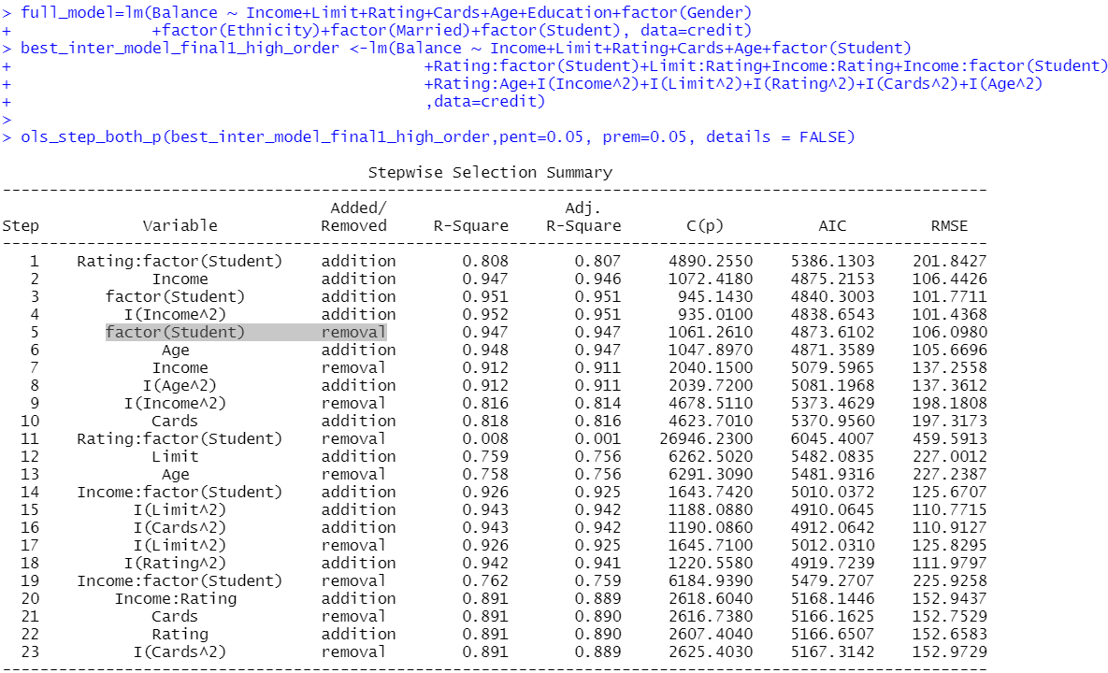
Stepwise regression is cumbersome

Slide 21
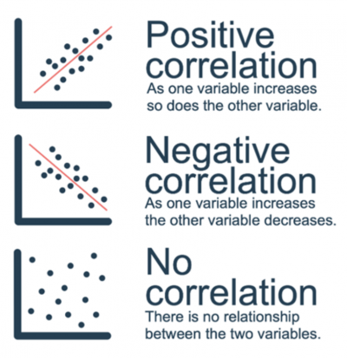
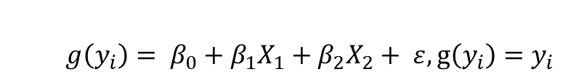
Correlation
response, coefficients of correlation, predictors
$$g\left(y_{i}\right)= β_{0}+β_{1}X_{1}+β_{2}X_{2}+ ε, g\left(y_{i}\right)=y_{i}$$
Correlations is an easy way to tell which predictors are mostly likely to have high orders
Correlation is a statistical measure that indicates the extent to which two or more variables fluctuate in relation to each other. A positive correlation (+) indicates the extent to which those variables increase or decrease in parallel; a negative correlation (-) indicates the extent to which one variable increases as the other decreases.
A correlation coefficient is a statistical measure, of the degree to which changes to the value of one variable predict change to the value of another.
Note, correlation does not imply causation.

Slide 22
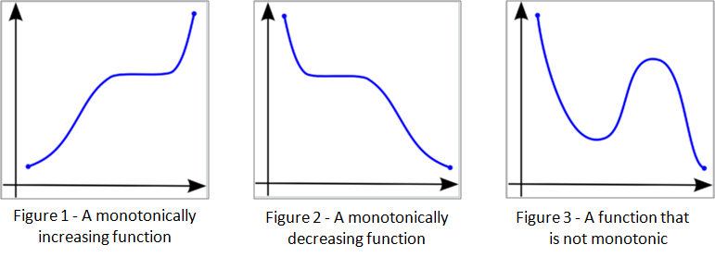
Correlation
Pearson correlation: Pearson correlation evaluates the linear relationship between two quantitative (continuous) variables. It’s also known as a parametric correlation test because it depends to the distribution of the data. It can be used only when x and y are from normal distribution.
Spearman (rank) correlation: Spearman correlation evaluates the monotonic relationship, suitable for both quantitative and qualitative variables. The Spearman correlation coefficient is based on the ranked values for each variable rather than the raw data.
Kendall’s Tau is a non-parametric measure of relationships between columns of ranked data. The Tau correlation coefficient returns a value of 0 to 1, where: 0 is no relationship, 1 is a perfect relationship.
A monotonic relationship is a relationship that does one of the following: (1) as the value of one variable increases, so does the value of the other variable; or (2) as the value of one variable increases, the other variable value decreases. Examples of monotonic and non-monotonic relationships are presented in the diagram below
Notes:
Monotonicity is "less restrictive" than that of a linear relationship. For example, the middle image above shows a relationship that is monotonic, but not linear.
A monotonic relationship is not strictly an assumption of Spearman's correlation. That is, you can run a Spearman's correlation on a non-monotonic relationship to determine if there is a monotonic component to the association. However, you would normally pick a measure of association, such as Spearman's correlation, that fits the pattern of the observed data. That is, if a scatterplot shows that the relationship between your two variables looks monotonic you would run a Spearman's correlation because this will then measure the strength and direction of this monotonic relationship. On the other hand if, for example, the relationship appears linear (assessed via scatterplot) you would run a Pearson's correlation because this will measure the strength and direction of any linear relationship. You will not always be able to visually check whether you have a monotonic relationship, so in this case, you might run a Spearman's correlation anyway.

Slide 23
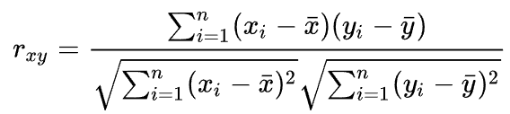
Pearson correlation
Pearson correlation evaluates the linear relationship between two quantitative (continuous) variables.
Requirements:
Scale of measurement should be interval or ratio
Variables should be approximately normally distributed
The association should be linear
There should be no outliers in the data

Slide 24
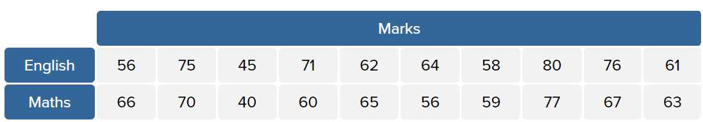
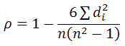
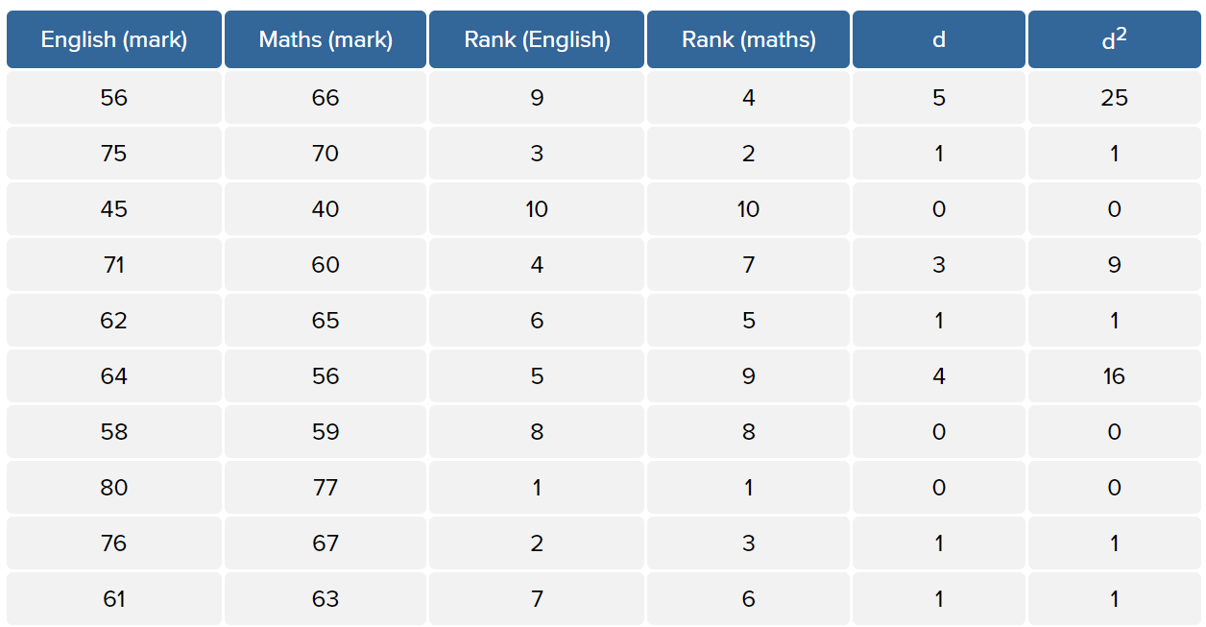
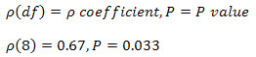
Spearman (rank) correlation
No tied observations
where d = difference between ranks and d² = difference squared.
Create a table of ranks, example of no tied observations
where df = N – 2, where N = number of pairwise cases.
H₀: There is no [monotonic] association between the two variables [in the population].
P value of spearman correlation < 0.05 means there is a monotonic association between two variables.
https://statistics.laerd.com/statistical-guides/spearmans-rank-order-correlation-statistical-guide.php
Notes:
For example, two items are equal placed in the 6th place. We cannot give rank 6 to both of them. So, we will take the average of the ranks they must have received if there was no tie. So, the average of ranks 6 and 7 will be taken and assigned to both the observations, which is 6.5. The following observation will be ranked as 8.

Slide 25
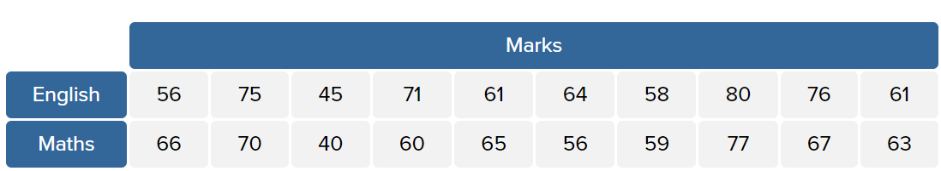
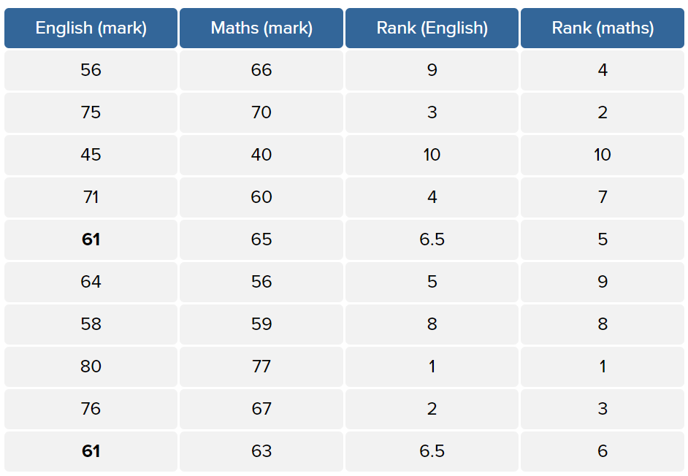
Spearman (rank) correlation
Create a table of ranks, example of tied observations
Tied observation,
where i = paired score.
It is important to realize that statistical significance does not indicate the strength of Spearman's correlation.
In fact, the statistical significance testing of the Spearman correlation does not provide you with any information about the strength of the relationship.
R code: cor(x, y, method=“pearson”)
https://statistics.laerd.com/statistical-guides/spearmans-rank-order-correlation-statistical-guide.php
Notes:
For example, two items are equal placed in the 6th place. We cannot give rank 6 to both of them. So, we will take the average of the ranks they must have received if there was no tie. So, the average of ranks 6 and 7 will be taken and assigned to both the observations, which is 6.5. The following observation will be ranked as 8.

Slide 26
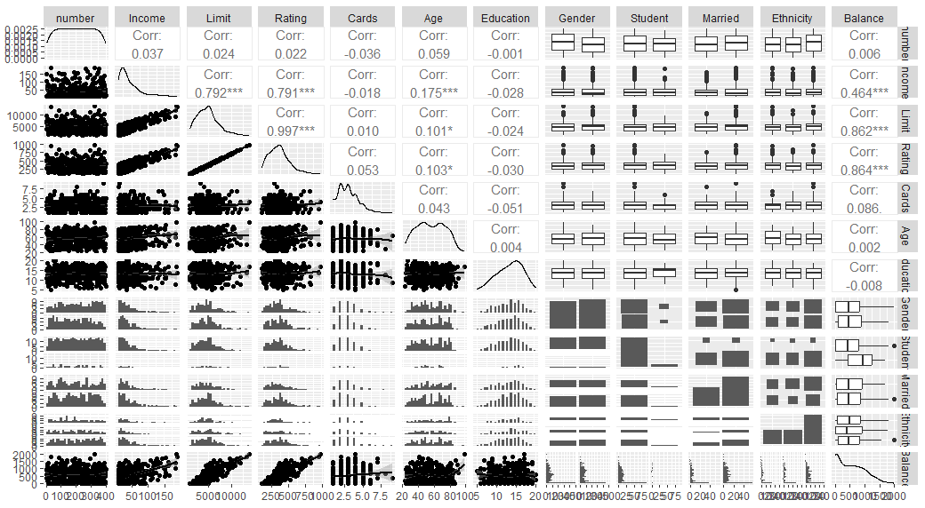
Correlation matrix
Library(GGally)
ggpairs(credit,lower = list(continuous = "smooth_loess", combo ="facethist", discrete = "facetbar", na = "na"))

Slide 27

In class Practice Problem 15
Clerical staff work hours. In any production process in which one or more workers are engaged in a variety of tasks, the total time spent in production varies as a function of the size of the work pool and the level of output of the various activities.
For example, in a large metropolitan department store, the number of hours worked (Y) per day by the clerical staff may depend on the following variables:
X1 = Number of pieces of mail processed (open, sort, etc.)
X2 = Number of money orders and gift certificates sold,
X3 = Number of window payments (customer charge accounts) transacted ,
X4 = Number of change order transactions processed ,
X5 = Number of checks cashed ,
X6 =Number of pieces of miscellaneous mail processed on an ‘’as available” basis , and
X7 =Number of bus tickets sold
The data are provided in CLERICAL.csv file count for these activities on each of 52 working days. Conduct a Stepwise Regression Procedure and All-Possible-Regressions procedure of the data using R software package.
Lecture_5.R
27

Slide 28
In class Practice Problem 15 Answers
Approach 1: Try to build a “best model” manually
Fit the model with all terms thought to be important as below in first order model.
Remove terms that are not significant with individual t-tests, this becomes model.
Conduct a partial F test using anova() to determine if this was justified.
The Partial F indicates removal of those terms was justifiable (strictly using α = 0.05).
Interactions don’t appear to improve anything, so let’s go back to the model with only first-order effects among the variables identified as significant on an individual t-test.
Now let’s check if we can improve the model with higher-order terms.
Approach 2: Use Stepwise regression
Run a stepwise regression on the additive model with all potential terms.
Take the output of stepwise regression and see if two-way interaction terms are justifiable.
Now let’s see if it is justifiable to add any second-order terms.
Approach 3: Use all-best-subsets regression
Run an all-best subsets regression, and then construct combos 5 table.
So, let’s move it forward and see if any two-way interactions are justified.
And finally, let’s see if we can justify any higher-order terms on these.
Lecture_5.R
28

Slide 29
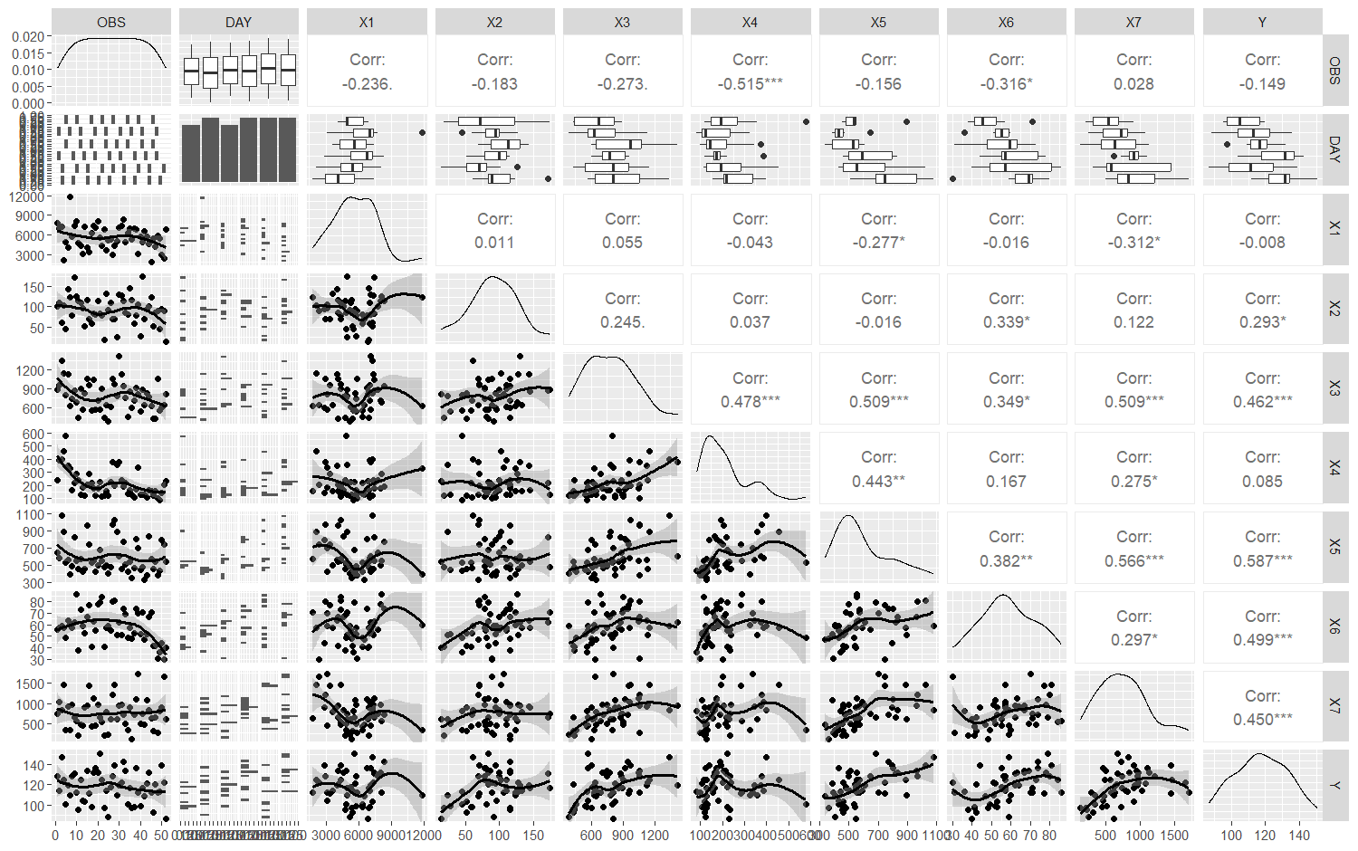

Slide 30
In class Practice Problem 15 Answers
Optimal models:
optimal_model_approach1=lm(Y ~ X2+X4+X5+I(X2^2), data=workhours)
optimal_model_approach2=lm(Y ~ X2+X4+X5+I(X2^2), data=workhours)
optimal_model_approach3 <-lm(Y~(X1+X2+X3+X4+X5+X6+X1:X6+X2:X6), data=workhours)
Lecture_5.R
30

Slide 31

Take away messages
Statistics:
Model selection based on p-values of predictor’s coefficients OR combos 5 criterion
Correlation measures the extent to which two or more variables fluctuate in relation to each other.
Pearson correlation
Spearman rank correlation
Code:
ols_step_best_subset
cor(x,y)
ggpairs(data, lower = list(continuous = "smooth_loess", combo ="facethist", discrete = "facetbar", na = "na")))

Slide 32

Thank you
Questions OR Comments?
Slack channel: section2-course-documents
Email: qing.li2@uclagary.ca

